Slide 1
MGMT 6055 Project Scope & requirements
Lawrence Kinlin School of Business
Module 6
Notes:
Content for slides in this PPT file is drawn significantly from PMBOK, 6th edition, published by PMI (required text for this course)

Slide 2
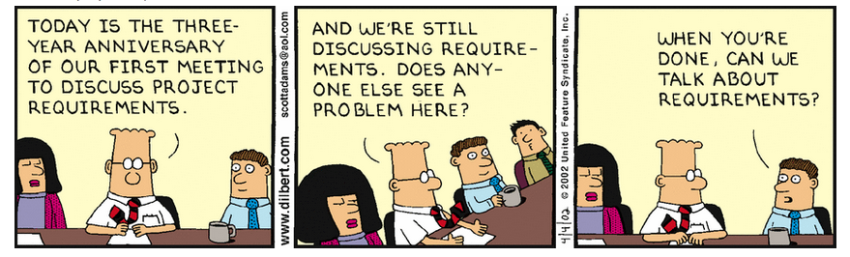
Notes:
Requirements (http://dilbert.com/strip/2002-04-04)

Slide 3
Objectives: Collect requirements – Tools & techniques (cont’d)
Interpersonal and team skills:
Nominal group technique
Observation
Facilitation (e.g., requirements workshops)
Context diagrams
Personas*
User stories*
Use cases*
* Personas, user stories, and use cases can be used to collect project requirements. They are described in the BABOK assigned readings.

Slide 4
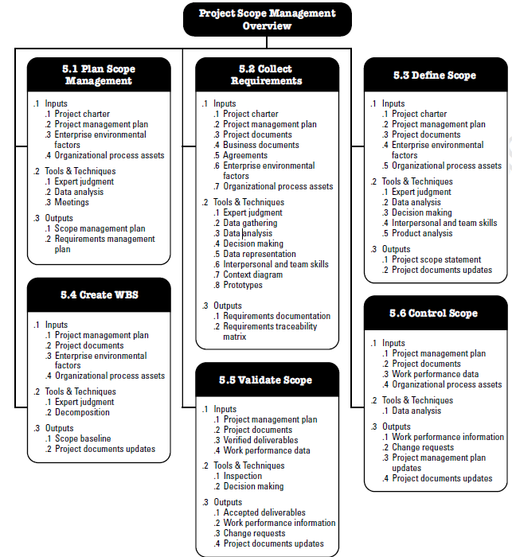
Recall from last module (in PMBOK 6th ed., p. 130)…
Notes:
Source: PMBOK 6th ed. (PMI)

Slide 5
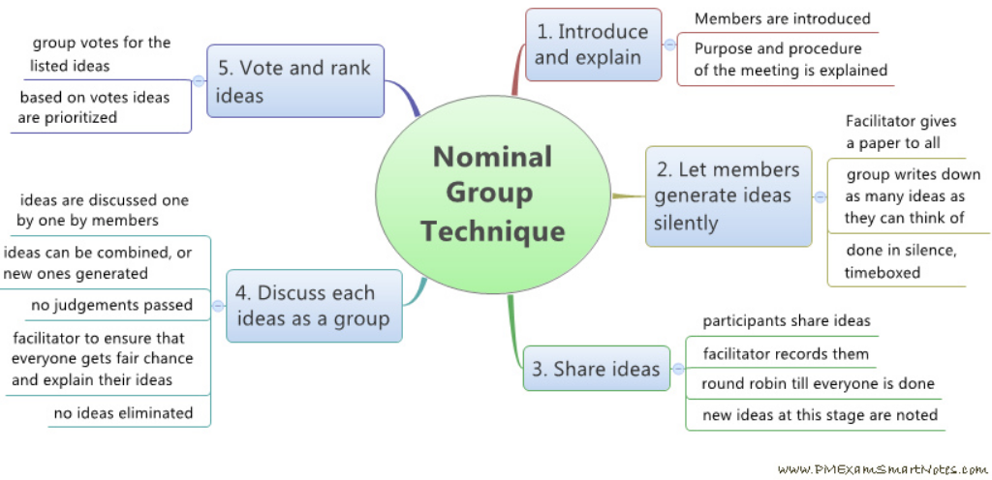
Interpersonal & team skills: nominal group technique
Privately brainstorm ideas (on paper), share ideas with group (write on board/wall), clarify ideas with group, privately rank ideas (on paper)
Notes:
Image source: https://www.flickr.com/photos/93642218@N07/8514741155
Explanation: e.g., https://www.rsna.org/NGT/ or http://asq.org/learn-about-quality/idea-creation-tools/overview/nominal-group.html

Slide 6
Interpersonal & team skills: observation/conversation
View individuals in their natural environment to understand how they behave
Used when it is difficult for the user to articulate what they are doing
Sometimes called job shadowing, may be done undercover
http://www.youtube.com/watch?v=rkb0r2-vYK0
http://www.youtube.com/watch?v=SYGVsAsdMSM

Slide 7
Interpersonal & team skills: facilitation (Requirements Workshops)
To identify and clarify requirements so they are clearly understood by the project team when documented
This might be a challenging process!
https://www.youtube.com/watch?v=BKorP55Aqvg

Slide 8
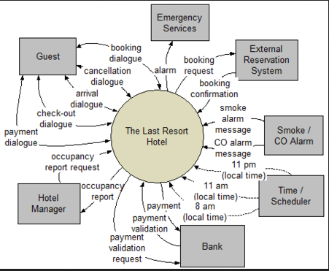
Context Diagrams
High-level visual maps of a system and how other people or other systems interface with it, including inputs, actors, and outputs
Maps external interfaces at high level of abstraction
Interactions or behaviours are NOT detailed
Usually used in engineering or IT applications
Notes:
Source: http://www.isanalisti.net/2011/06/context-diagram/

Slide 9
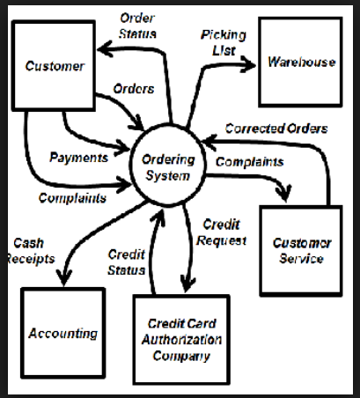
Context Diagrams
Notes:
Source: https://www.google.ca/url?sa=i&rct=j&q=&esrc=s&source=images&cd=&cad=rja&uact=8&ved=2ahUKEwjQ-Kna3uDdAhUE8IMKHSGLBwoQjRx6BAgBEAU&url=https%3A%2F%2Fstudy.com%2Facademy%2Flesson%2Fsystem-context-diagram-description-examples.html&psig=AOvVaw2Yo-ZlyrXMikWQQQf-IZgV&ust=1538328573926057
Explanation from https://www.jamasoftware.com/blog/defining-project-scope-context-use-case-diagrams/: The context diagram depicts the project scope at a high level of abstraction. This diagram deliberately reveals nothing about the system internals: no information about functionality, architecture, or look-and-feel. Nor does it explicitly identify which features or functionality are in scope and which are not. The functional behavior of the system is merely implied by the labeled flows that connect the system to the external entities. Even the flows are labeled at a high level of abstraction, just to keep the diagram’s complexity manageable.

Slide 10
Personas
Imaginary representation of a user role
Defined by their goals, motivations, and behaviours (e.g., cheap, outgoing, embraces technology, likes/dislikes)
Sufficiently detailed so that everyone on the project team feels like they “know” the persona and can identify requirements of the persona characterization/role
IF you want to read more about personas to understand them better… click here
Notes:
How personas and user stories link together: https://www.justinmind.com/blog/user-personas-scenarios-user-stories-and-storyboards-whats-the-difference/

Slide 11
Creating a Persona
Get all the stakeholders involved
Use your subject matter experts (because personas are NOT stereotypes, they’re based on reality)
Construct a persona or characterization of a typical end-user of the product/process you’re creating for the project
What do they value
What is their history (where do they come from)
What are their goals
Education, work experience, age, income
What are their attributes (with respect to the product)
Include a picture (find a picture of someone on the Internet and this person will be a visual representation of your persona character)
Objective is to envision requirements of the persona

Slide 12
Examples of Personas
Grandparents
Hacker
iPhone user
Bank teller
McDonalds cashier
Football player
College student

Slide 13
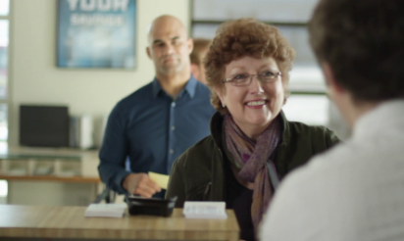
Persona example #1
Elderly Bank Customer (Frances Miller)
Notes:
https://www.google.ca/url?sa=i&rct=j&q=&esrc=s&source=images&cd=&cad=rja&uact=8&ved=2ahUKEwiV8src5-DdAhXFxYMKHb4JDyUQjRx6BAgBEAU&url=https%3A%2F%2Fwww.videoblocks.com%2Fvideo%2Ffemale-customer-gets-cash-from-bank-teller-over-the-shoulder-shot-from-behind-teller-showing-other-customers-and-bank-interior-camera-mounted-on-jib-arm-hgzrt7wqgizu3o74u&psig=AOvVaw0fEq-oLJE4dUluvVLE_Iw3&ust=1538330959655582

Slide 14
Frances Miller
Sixty-seven year-old Frances is the mother of four children and the grandmother of twelve.
She is a middle-class retiree living on a fixed income. Her mortgage has been paid off and she has one credit card which she seldom uses. She has been a customer of the bank for 57 years although has never used an automated teller machine (ATM) and never intends to. She has no patience for phone banking. Even though her children gave her a computer for her birthday a few years ago, she doesn’t like to use it because it is too complicated for her.
Every Monday at 10:30 am she will visit her local bank branch to withdraw enough cash for the week. She prefers to talk with Selma the branch manager or with Robert.
Notes:
http://www.agilemodeling.com/artifacts/personas.htm

Slide 15
Question:
You are collecting requirements for a bank website redesign project.
The bank has thousands of customers like Frances Miller.
Can you think of design features or functions that the bank might implement on its website, which might be helpful/useful for customers such as Frances?
Notes:
http://www.agilemodeling.com/artifacts/personas.htm

Slide 16

Persona example #2
Project Manager (Kim Callahan)
Notes:
Image Source: https://www.google.ca/url?sa=i&rct=j&q=&esrc=s&source=images&cd=&cad=rja&uact=8&ved=2ahUKEwjNt6_Z5uDdAhUh8IMKHXpJADkQjRx6BAgBEAU&url=https%3A%2F%2Fwww.wrike.com%2Fblog%2Fprogram-manager-vs-project-manager%2F&psig=AOvVaw2RKy_y4eKRFsnJIaoGQQ7r&ust=1538330712564370

Slide 17
Kim Callahan
Kim is 35 years old and is a PMP certified project manager. Her background is in engineering. As a child, Kim’s analytical mind was already developing. She loved breaking her toys and putting them back together. As a teenager and into adulthood, one of her favourite hobbies has been doing jigsaw puzzles. She has a very organized mind, and enjoys listening to engineering/design podcasts while working on her puzzles.
Kim works for a 25 year old Fortune 100 company. She works with 20 people across four projects. She runs the Product Approval Committee for one of those projects, and she is a core member of the other three product teams. Her company uses a seven-phase Product Life Cycle process. She uses MS Project to manage her projects, and when people need to see the work breakdown structure, she emails them a PDF file or a soft copy of the MS Project files. If they need to update it, they send it back to her with changes.
Notes:
http://www.slideshare.net/UPABoston/persona-development

Slide 18
Question:
You are part of a software development team. Your company is creating a brand new project management software program that will compete with other popular programs such as Microsoft Project.
Can you think of design features or functions that might be incorporated into the new project management software program, which might be helpful/useful for customers such as Kim?
Notes:
http://www.agilemodeling.com/artifacts/personas.htm

Slide 19
Data representation: user stories
“A concise statement of functionality or quality needed to deliver value to a specific stakeholder” (BABOK 3.0)
User stories are used to spark discussion about requirements and generate acceptance criteria
Common structure of statement: who-what-why
“As a <who>, I need to <what>, so that <why>”
Notes:
How personas and user stories link together: https://www.justinmind.com/blog/user-personas-scenarios-user-stories-and-storyboards-whats-the-difference/

Slide 20
Data representation: user stories
“As an elderly bank customer with limited technical knowledge, I need to be able to see my current bank balance, so that I can decide how much money to withdraw.”
“As a project manager who works with 20 team members, I need to keep track of changes to the project schedule, so that I don’t accidentally use an old version for decision-making.”
Notes:
How personas and user stories link together: https://www.justinmind.com/blog/user-personas-scenarios-user-stories-and-storyboards-whats-the-difference/

Slide 21
Data representation: Use Case
A use case defines a goal-oriented set of interactions between external actors and the system under consideration
Your personas (actors) are the users
Use cases are initiated by a user with a particular goal in mind. The use case is completed successfully when that goal is satisfied
It describes the sequence of interactions between actors and the system
Helpful for identifying functional requirements
For more information on constructing a use case, you can check out this link if you wish…
Notes:
http://www.bredemeyer.com/use_cases.htm

Slide 22
The Actor
The Use Case
Performs a role in a system
Interacts with the use case (the process)
A visual representation of a distinct functionality, behaviour, or activity in a system
Make an appointment
Doctor
Yes, create a stick figure! (or use a picture of the actor)
Each interaction within the system has an oval drawn around it….
Notes:
It is simple http://www.developer.com/design/article.php/2109801/Creating-Use-Case-Diagrams.htm

Slide 23

System Boundary and title
A system boundary (with title) defines the scope of what a system will be
Doctor’s Office
Draw one rectangle around all of your ovals. Draw a line between each actor and the transaction that the actor participates in. Add a title for the system at the top of the boundary.
Make appointment
Patient
Perform medical tests
Doctor

Slide 24
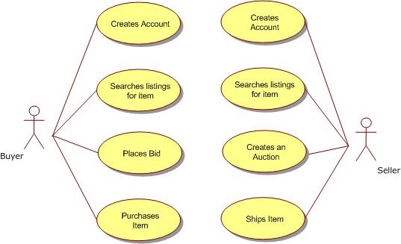
Example: Use Case diagram for ….?
Title of System: ?
In this system, the actors don`t interact – the behaviours are asynchronous, so there are no bubbles with lines between two actors. If actors interact to complete an activity, lines will connect both actors to the behaviour bubble. Can you think of a behaviour in this system where the two actors DO interact?

Slide 25
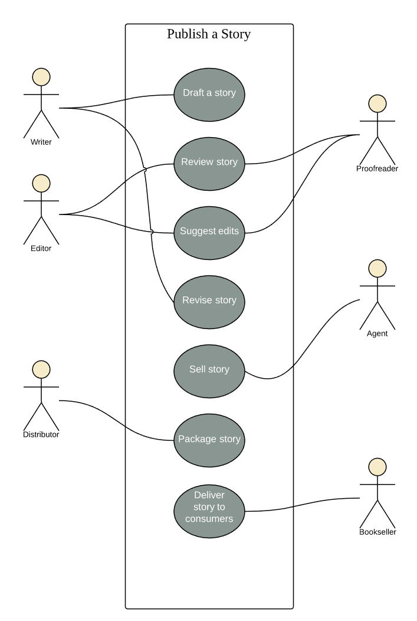
Example: Publishing a story
Notes:
https://www.lucidchart.com/pages/uml-use-case-diagram

Slide 26
(OPTIONAL) activity: multi-screen movie theatre
You are an Interior Designer. You have been hired to design the interior layout of a new multi-screen movie theatre that is being built in your city.
Create a use case diagram for a ‘multi-screen movie theatre’ that includes the following four actors:
- customer
- ticket seller
- ticket taker/usher
- snack bar employee
Notes:
https://www.lucidchart.com/pages/uml-use-case-diagram

